Slide 1
Presentation to the Board of Directors:
CCMP Update
10-Year Implementation Plan
2025-2027 EPA Base Workplan

Slide 2
CCMP Update, Implementation Plan, Workplan – How they fit together
Comprehensive Conservation & Management Plan
The environmental goals, metrics, and milestones that we stive to achieve over time. This is a core requirement of each National Estuary Program.
10-Year Implementation Plan
A combination of the Habitat Protection/Restoration Strategy and Finance Strategy. Identifies CCMP priorities and goals, potential partners, funders, and implementation strategies for the 10-year period.
Biennial Workplan
Identifies how we will utilize Section 320 Clean Water Act funds to meet the goals of our CCMP during the period. Includes identification of goals, actions, accomplishments, key staff, budget and match.

Slide 3
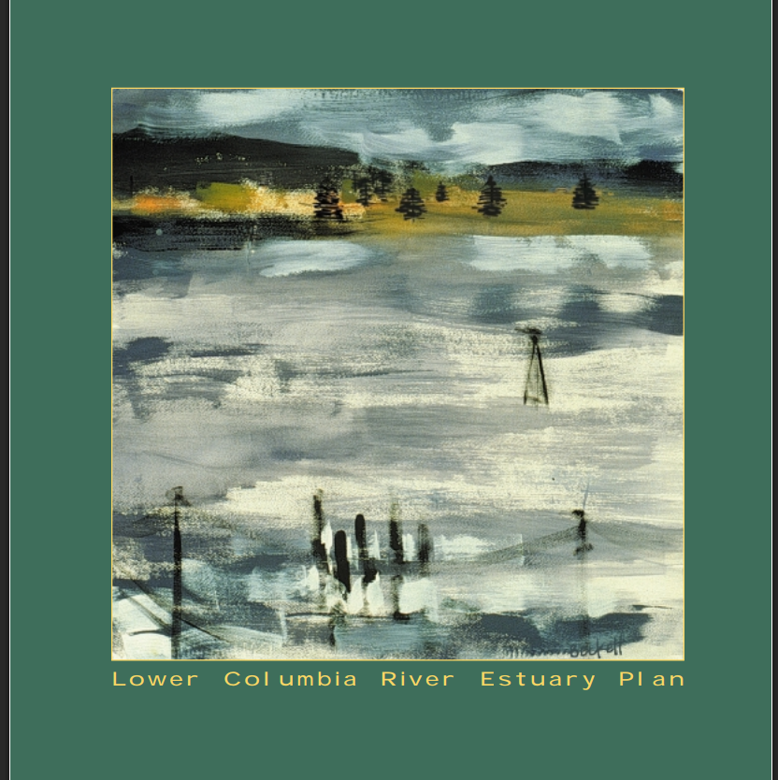
Comprehensive Conservation & Management Plan
Available online at https://www.estuarypartnership.org/who-we-are/our-management-plan
The Original, full CCMP consists of 3 Volumes.
The CCMP Updates that have been completed since 1999, including the current 2024 Update, are revisions to Volume 1, Chapter 5. Chapter 5 is where the listing of Actions reside.
The Original CCMP Chapter 5 had 47 Actions. The 2011 Update reduced the Actions to 17. The current Update does not change the number of Actions.

Slide 4
Update Process:
Feb. 2024
Retreat with Board and staff to identify the key areas of focus for the Update.
Climate Change
Environmental Justice
Access and Recreation
Community Education
Spring 2024
Began collecting input from partners
Sep. 2024
Walk and Talk at Fort Clatsop National Park hosted by NPS, CREST, and the Estuary Partnership
Oct. 2024
New CCMP Guidance released
Dec. 2024
Initial Draft complete
Jan. 2025
Revisions to align with Authorizing language.
Feb. 2025
Final Draft complete. To Board for approval to submit.

Slide 5
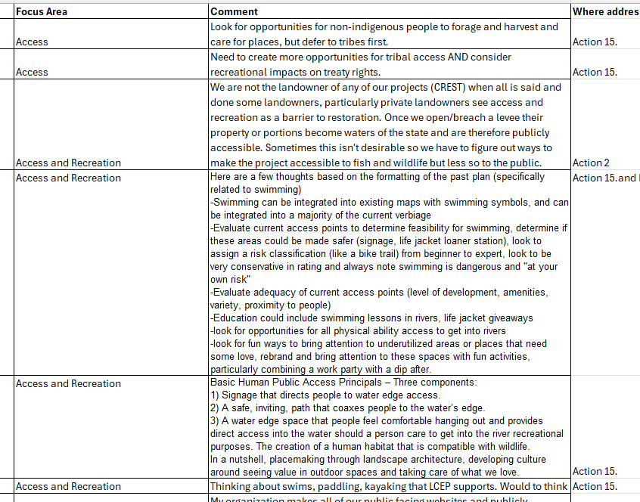
Comments Received:
We received comments from 11 federal, state, and local partners.
Most of the comments received were related to specific targets.
Other comments were specific to areas of focus or more general in nature.
The original draft of the Update included identification of where comments were addressed.
A comment matrix that identifies where in the Update or Implementation Plan a comment was addressed was compiled and is available.

Slide 6
CCMP Update Overview:
The Update is an Update of the Actions in Volume 1, Chapter 5
The overall goals and focus of the 1999 Management Plan remain the same. This is work that is long-term.
Updates to the language of the Plan were made throughout the document, substantive changes include updates to the Actions; updates to the “how” statements; updates to the Targets.
A listing of all substantive changes, by page number, is complete and will be submitted with the CCMP for review.

Slide 7
Jumping In. . .
Presenting the 2024 Update of Actions to the Lower Columbia Estuary Partnership’s Comprehensive Conservation & Management Plan

Slide 8
What’s New and Revised:
The Mission has been updated.
The Introduction has been updated to include:
Updated description of the Study Area that reflects the Study Areas full description found in the full CCMP.
All sources and referenced studies have been updated.
The Objectives of the 2024 Update were stated:
Assess the current actions for their relevancy and consideration of recurring extreme weather events on the estuary, vulnerable communities, access, recreation, and community education.
Update measures and provide updated targets where appropriate.
Integrate updated habitat restoration targets and ensure the Update reflects our learning and progress from 30 years of work.
Update actions and integrate measures that are informed by the identification and assessment of vulnerabilities in the estuary including the Estuary Partnership’s assessments of sea level rise, cold water refuges, and carbon and methane fluxes.

Slide 9
Updates continued:
The accomplishments section, “Progress Since 2011,” has been updated.
This section list some of the key accomplishments since 2011 in the following areas:
Habitat Restoration
Water Quality and Toxics Reduction
Science
Education and Stewardship
Regional Coordination
Stormwater Green Infrastructure
Partnerships

Slide 10
Actions:
We utilized the same format that was established with the 2011 Update to list the Actions and Identify the activities, Targets and other important aspects of each Action.
We eliminated the identification of Actions as either “Shared” or “Estuary Partnership” Actions. The primary distinction between different Actions is how the Estuary Partnership tracks and reports, not whether actions are shared. Actions that the Estuary Partnership has very little role in are still Shared Actions. This is discussed more fully in the document.

Slide 11
Updated Actions:
ACTION 1: Inventory habitat types and attributes in the lower Columbia River and estuary and prioritize those that need protection and conservation; identify habitats and environmentally sensitive lands that should not be altered. Update periodically to reflect emerging science and issues.
ACTION 2: Protect, conserve, restore, and enhance priority habitats, particularly wetlands, on the mainstem and within tributaries of the lower Columbia River and in the estuary.
ACTION 3: Monitor status and trends of ecosystem conditions and effectiveness of management actions.
ACTION 5: Avoid the introduction and reduce the prevalence of non-native invasive species.
ACTION 9: Ensure that development is ecologically sensitive and reduces carbon greenhouse gas emissions.
ACTION 14: Create and implement education and volunteer opportunities for citizens community members of all ages to engage in activities that promote stewardship of the lower Columbia River and estuary.

Slide 12
Action 1:
ACTION 1: Inventory habitat types and attributes in the lower Columbia River and estuary and prioritize those that need protection and conservation; identify habitats and environmentally sensitive lands that should not be altered. Update periodically to reflect emerging science and issues.
Targets:
Update the map of habitats every ten years.
Develop a map that estimates greenhouse gas sequestration potential by 2030.
Maintain and update criteria and tools to identify priority species and maps of their priority habitats.
Update and maintain maps that provide information and tools related to vulnerabilities in the estuary due to recurring extreme weather events, accelerated land loss, and sea level rise.

Slide 13
Action 2:
ACTION 2: Protect, conserve, restore, and enhance priority habitats, particularly wetlands, on the mainstem and within tributaries of the lower Columbia River and in the estuary.
Targets:
No net loss of native habitats from the 2009 baseline;
Recover 30% (10,382 acres) of the historic coverage of priority* native habitats by 2030; and
Recover 40% (22,480 acres) of the historic coverage of priority native habitats by 2050.
*Priority habitats are those identified in 2016 as rare habitats historically and those that the lower Columbia River has lost the most of from conversions to urban, industrial, and agricultural development.
Note: This is an important update that we’ll dig into a bit more with the Implementation Plan. The SWG identified these new habitat coverage targets.

Slide 14
Action 3:
ACTION 3: Monitor status and trends of ecosystem conditions and effectiveness of management actions.
Targets:
Assess at least 20 additional projects representing a broad geography, restoration method, and type of habitat in the habitat effectiveness monitoring program by 2035.
Continue to sample and analyze a full suite of indicators at fixed sentinel locations that represent the estuarine-tidal freshwater gradient through 2035 as part of the ecosystem monitoring program.

Slide 15
Action 4 and Action 5:
ACTION 4: Establish and maintain Columbia River flows to meet ecological needs of the lower Columbia River and estuary.
Targets:
1. Increase the amount of water dedicated to meeting minimum flows between 1999 and 2035.
ACTION 5: Avoid the introduction and reduce the prevalence of non-native invasive species.
Update the inventory of invasive species by 2035.
Provide programs and technical assistance to encourage the restoration and protection of native species with high cultural value such as wapato, cattail, and lamprey.
Make state lists of banned plants and invasive species accessible to a range of issuers and users, e.g. nurseries, etc., and update banned list every five years.

Slide 16
Action 6:
ACTION 6: Manage human-caused changes in river morphology and sediment distribution within the Columbia River channel to protect native and desired species.
Targets:
Develop a sediment transport model for the lower river to inform appropriate locations for dredge material placement.
Inventory and map in-water structures that affect flow as part of the shoreline inventory every five years.

Slide 17
Action 7 and Action 8:
ACTION 7: Develop floodplain management and shoreland protection programs.
Targets
Reduce by 10% armored or structured shoreline by 2030.
Reduce by 30% non-water dependent structures in the floodplain and floodway by 2030
Map and make publicly available a 200-year floodplain map by 2030.
Update the Estuary Partnership shoreline inventory every ten years.
ACTION 8: Reduce and improve the water quality of stormwater runoff and other non-point source pollution.
Targets
Increase on-site retention by 35% by 2035.
Increase regenerative and environmentally sustainable practices on farms, roadway rights-of-way, and forestry lands by 2035.
Complete at least 2 stormwater retrofit projects annually, beginning in 2024.

Slide 18
Action 9:
ACTION 9: Ensure that development is ecologically sensitive, reduces greenhouse gas emissions, and reduces “heat island” effects.
Targets
Decrease impervious surface in tracts with high disparity (disadvantaged) by 5% by 2035.
Increase by 10% mass transit, carpooling, walking, and bicycle commuting in the metro area by 2030.
Reduce by 30% the ratio of converted land to population growth by 2030.
Increase coverage of open space and trees and shrubs in urban areas by 35% by 2035.

Slide 19
Action 10:
Action 10: Expand and sustain regional monitoring of toxic and conventional pollutants.
Targets
Update the monitoring strategy through a collaborative process by 2035 and every ten years thereafter.
Review and update a regional list of priority contaminants targeted for reduction by 2030.
Regularly monitor and analyze the full suite of priority contaminants at a minimum of 30 sites by 2030 and report on impact on ecosystem and human health.
Identify trends in contaminants and impacts of reduction actions by 2035 to adaptively manage.

Slide 20
Action 11:
Action 11: Reduce conventional pollutants.
Targets
Decrease by 50% the number of streams that do not meet water quality standards by 2030.
Reduce discharges by 25% from nonpoint sources by 2035.
Put in place trading opportunities among dischargers by 2035

Slide 21
Action 12:
Action 12: Clean up, reduce, or eliminate toxic contaminants, particularly contaminants of regional concern.
Targets
Clean up a minimum of five “hot spots” by 2030.
Render hazardous waste sites harmless by 2050.
Reduce sales of products containing contaminants (fertilizers, pesticides, personal care products) by 2030.
Expand regional pharmaceutical take back programs with law enforcement and medical providers by 2030.
Hold pesticide and fertilizer take back programs in multiple locations annually.
Remove marine debris at a minimum of 40 sites by 2035.
Remove another 10% of mapped derelict vessels by 2030.
Remove chlorine from wastewater treatment and industrial processes by 2040.

Slide 22
Action 13:
ACTION 13: Provide information about the lower Columbia River and estuary that focuses on water quality, endangered species, habitat loss and restoration, biological diversity, and the effects of recurring extreme weather events on the estuary to a range of users.
Targets
Reports, publications, and information:
Issue a state of the estuary report that tracks indicators and reports natural resource trends and Estuary Partnership activities every five years.
Publish technical analyses of topics including toxic contaminants by 2027 and every ten years thereafter.
Publish the inventory and status of habitat restoration efforts in the region annually.
Consistently distribute information to consumers and land users through various means, e.g., media, print materials, websites, workshops.
Exchange and sharing of information:
Host at least one Science to Policy Summit every two years.
Host or co-host a regional scientific workshop or conference at least every three years.
Update technical information on website annually.

Slide 23
Action 14:
ACTION 14: Create and implement education and volunteer opportunities for community members of all ages to engage in activities that promote stewardship of the lower Columbia River and estuary.
Targets
Provide a minimum of 20,000 hours of river and environmental education programs to at least 3,000 students in K-12 grade annually.
Organize a minimum of ten volunteer opportunities engaging a minimum of 250 volunteers contributing 750 hours of volunteer time annually.
Update curriculum at least once a year.
Create community outreach and education plans for at least 50% of restoration projects that identify opportunities for education and public stewardship; include accessibility plan (if appropriate); create listservs, social media, and other opportunities for community learning and engagement.

Slide 24
Action 15:
ACTION 15: Identify and improve public access to the river.
Targets
Update the Water Trail website at least annually.
Install Water Trail wayfinding signs at locations of interest, campgrounds, and other sites by 2027.
Conduct at least one cleanup or maintenance of a Water trail site annually as part of the volunteer program.
Conduct at least one cleanup or maintenance of a swimming area along the Willamette, as part of the volunteer program, annually.
Conduct at least twenty-five paddles annually with partners and community members.
Complete testing at one site used for harvest of culturally important first foods at least annually.

Slide 25
Action 16:
Action 16: Facilitate and assist federal, tribal, state, and local governments protection of the lower Columbia River and estuary.
Targets
Implement projects annually in at least five counties that advance habitat restoration or water quality goals of the states and federal government.
Provide expertise to a minimum of two other organizations annually concerned with lower river resources such as Vancouver Lake Partnership, Oregon Abandoned and Derelict Vessels Workgroup, Lower Columbia Solutions Group, EPA Columbia River Toxics Reduction Working Group, and others.

Slide 26
Action 17:
ACTION 17: Create and maintain a regional entity (Lower Columbia Estuary Partnership) to advocate for the lower Columbia River and estuary and unify and coordinate Management Plan implementation.
Targets
Assess current activity and progress regularly and define a ten-year strategy to implement activities in the Management Plan.
Develop a funding strategy to support the implementation strategy.
Update the status of implementation strategy activities annually.
Maintain or grow state and federal National Estuary Program funding.
Maintain diversified funding.
The Columbia River Basin Restoration Program is reauthorized regularly.
Make annual federal appropriations requests.

Slide 27
Tracking and Reporting:
This section of the Plan essentially outlines how the CCMP, the Implementation Plan and the Biennial Workplan connect to each other.
It also outlines how we track and report data.
Tracking implementation of the actions and
Tracking progress toward meeting targets.
The Estuary Partnership tracks the overall number of actions being implemented, but
Tracking progress in meeting targets varies.
The Estuary Partnership implements projects to address various Actions, but not all Actions, and tracks and evaluates progress toward meeting the targets where that information is available. The Estuary Partnership will track Actions 1, 2, 3 and 10 as part of its NEP responsibilities (annual NEPORT reporting). For the remainder, the Estuary Partnership will try to collect data or information from various sources.

Slide 28
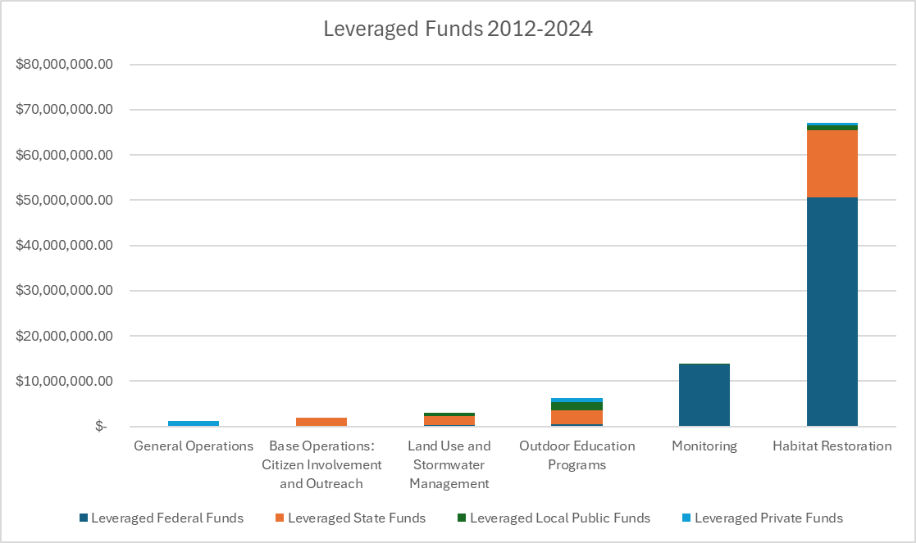
Financial Planning and Funding Section:
Financial Section:
This is more historical financial data while the Implementation Plan has more forward looking financial and funding data. But quite interesting. The table to the left shows the source of leveraged funds and what types of projects those funds were used for.

Slide 29
2011-2024 Financial Data:
$93 million in competitive funds secured since 2012.
EPA Base Funding has provided 8% of total funding between 2012 and 2024, with $7.8 million in funding – a 12:1 ratio over that period.
Where the funding went:
Habitat Restoration $67 million
Monitoring Programs $13.7 million
Environmental Education $6.1 million
Community Involvement & Outreach $3.1 million
General Operations $1.2 million

Slide 30
Next Steps:
The Board should consider if the CCMP should be approved for submittal to EPA Region 10 for review and approval.
This will require a motion and vote of the Board.

Slide 31
10-Year Implementation Plan
This is the plan that helps guide our implementation of the CCMP over the next 10 years.
The 10-year window aligns with when our next CCMP Update will be required.

Slide 32
Goals for the 10-Year Implementation Plan:
Estuary Partnership Goals in this 10-Year Implementation Window:
Increase habitat and habitat function for multiple species; recover 30% (10,382 acres) of historic extent for priority habitats by 2030, and 40% (22,480 acres) of historic habitat coverage of priority habitats by 2050.
Develop an inventory of greenhouse gas sequestration potential by habitats across the lower river.
Reduce or remove contaminants and clean up contaminated sites to improve water quality; work with policy makers to secure long-term funding and support for toxics monitoring in the lower river and larger basin.
Provide education and engagement activities and provide data and information for a range of audiences; reach 3,000 students each year during 20,000 hours of river and environmental education programming; engage with 250 volunteers annually; and expand learning and engagement by creating community outreach and education plans for at least 50% of Estuary Partnership restoration and stormwater projects.
Convene and coordinate partners to enhance regional strategies and partnerships and heighten protection of the lower Columbia River, including hosting Science to Policy Summits, Columbia River Estuary Conferences, and participating in a range of local, regional, and national collaborations and conversations.

Slide 33
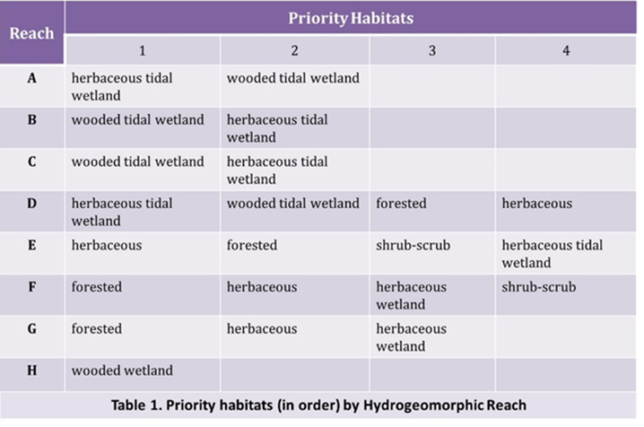
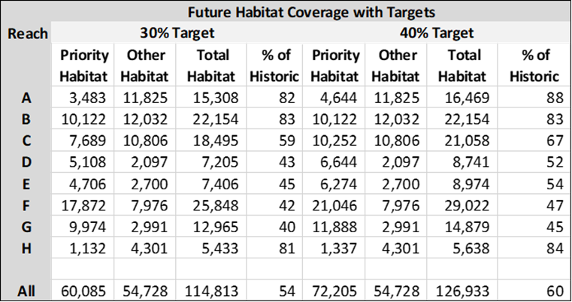
New Habitat Targets:
This takes us back to Action 2 in the CCMP and the updated Targets – Recover 30% of priority habitats by 2030 and 40% by 2050.

Slide 34
Climate Change Stressors and Impacts of Living Resources:
The Estuary Partnership will continue to study and implement actions to address the impacts of climate change0, including;
Identifying, protecting, and enhancing cold-water refuge areas for salmon survival
Assessing the impacts of sea level rise and increased riverine flooding on lower Columbia wetlands
Working with communities and partners to assess, identify, and generate solutions that address vulnerabilities and increase resilience
Identifying opportunities to increase the understanding of harmful algal blooms in area waterways and assess actions to address
Consider restoration techniques such as living shorelines, hyporheic exchange, and nature-based solutions
Develop an inventory of greenhouse gas sequestration potential by habitats across the lower river.

Slide 35
Table of Key Strategies:
For each Action: Column 1 and 3 come directly from the CCMP. Column 2 applies a range of costs and considers possible funding sources. Column 4 are performance measures – quantitative data, primarily, that the Estuary Partnership will track annually.
Proposed action plan timeframe, and where appropriate, key milestones for completion; | Estimate the range of potential costs of the overall action and identify the possible sources of funding; | Targets, including protection and restoration targets (if applicable): Note: All CCMP Targets included. | Performance measures- (What the Estuary Partnership will track annually)
Note: Actions that the Estuary Partnership doesn’t have strategies to implement are not included in this presentation, but they are in the Implementation Plan.

Slide 36
Action 1:
Proposed action plan timeframe, and where appropriate, key milestones for completion; | Estimate the range of potential costs of the overall action and identify the possible sources of funding; | Targets, including protection and restoration targets (if applicable): Note: All CCMP Targets included. | Performance measures- (What the Estuary Partnership will track annually)
1. Habitat maps updated by 2034 2. Map greenhouse gas sequestration potential by 2030. 3. Update Landcover Dataset by October 2025, with update by 2035 4. Refine regional carbon calculators, ongoing | 1. Habitat Map data ~ $100,000 to update in 2034. Potential Funding sources - EPA, State of OR, State or WA. 2. Greenhouse gas sequestration potential mapping ~$275,000/year assessment and analysis phase (2024-2027), ~ $100,000 - $250,000 for mapping, ongoing costs not identified. Funded 2024-2026 EPA BIL, future potential funders EPA, States, competitive funding sources. 3. ~$50,000-$100,000/year to update carbon calculators. Not currently funded, potential future funders EPA, competitive funding sources. | 1. Update the map of habitats every ten years. 2. Develop a map that estimates greenhouse gas sequestration potential by 2030. 3. Maintain and update criteria and tools to identify priority species and maps of their priority habitats. 4. Update and maintain maps that provide information and tools related to vulnerabilities in the estuary due to recurring extreme weather events, accelerated land loss, and sea level rise. | 1. # of staff/contractors’ hours spent in assessment and/or analysis of carbon/methane flux. 2. $ spent on assessment and analysis of carbon/methane flux, and source of funds. 3. # of staff/contractor hours spent in habitat assessment. 4. $ spent on habitat assessment. 5. # of reports provided, and to whom, on assessment, analysis, mapping addressed in this action.

Slide 37
Action 2:
ACTION 2: Protect, conserve, restore, and enhance priority habitats, particularly wetlands, on the mainstem and within tributaries of the lower Columbia River and in the estuary. | 1. All activities are ongoing. 2. Complete the landcover dataset update in 2025, and in 2035 (Action 1). | 1. Project development, collaboration, funding development ~ $100,000 - $250,000 per year. Not currently fully funded. Potential future funding sources - EPA, BPA, competitive funding sources. 2. Individual project site feasibility, assessment, design ~ $200,000 and up. Site specific. Various local, state, and federal competitive funding sources. 3. Individual project site construction and maintenance ~$250,000 and up. Site specific. Various local, state, and federal competitive funding sources. | 1. No net loss of native habitats from the 2009 baseline; 2. Recover 30% (10,382 acres) of the historic coverage of priority* native habitats by 2030; and 3. Recover 40% (22,480 acres) of the historic coverage of priority native habitats by 2050. ◦Priority native habitats include; herbaceous tidal wetland, wooded tidal wetland, forested, herbaceous, shrub-scrub. Priority is identified by river reach A through H. | 1. # acres of each habitat type restored annually, further identified by location and what entity accomplished. 2. # acres of each habitat type protected or conserved annually, further identified by location and what entity accomplished. 3. Total # acres restored, protected or conserved annually. 4. Cumulative acres restored, protected or conservative reported annually. 5. Total $ annually of restoration, protection or conservation annually, further identified by funding source.

Slide 38
Action 3:
ACTION 3: Monitor status and trends of ecosystem conditions and effectiveness of management actions. | 1. Complete annual ecosystem monitoring at 3-5sentinel sites annually. 2. Complete action effectiveness monitoring at all sites in accordance with approved monitoring plans - annually. 3. Expand the use of UAV to make monitoring more efficient and effective as appropriate -. | 1.Annual cost to maintain a 4-5 person monitoring team to complete all AEM and EMP monitoring plans, including travel ~$1.5m. Currently funded by BPA and specific project funders for monitoring plan implementation. 2.Annual UAV costs including inventory maintenance, insurance, certifications, maintenance ~ $100,000 to $250,000/year. Currently funded by BPA and project funders. | 1. Assess at least 20 additional projects representing a broad geography, restoration method, and type of habitat in the habitat effectiveness monitoring program by 2035. 2. Continue to sample and analyze a full suite of indicators at fixed sentinel locations that represent the estuarine-tidal freshwater gradient through 2035 as part of the ecosystem monitoring program. | 1. # of acres monitored annually by EMP. 2. # sites monitored annually by EMP, further identified by location. 3. # acres monitored annually by AEM. 4. # of sites monitored annually by AEM, further identified by location. 5. # and location of sites where UAVs were used for monitoring. 6. # of acres monitored annually using a UAV.

Slide 39
Action 8:
ACTION 8: Reduce and improve the water quality of stormwater runoff and other non-point source pollution | 1. Complete stormwater retrofits annually at schools and other public spaces. 2. Install native trees and shrubs with stormwater retrofit projects - ongoing. | 1. ~ $100,000 per year for community outreach, project development and proposal development. Currently funded (2024-2026) by CRBRP Stormwater program funds. Future funding sources include EPA, States, local governments, other competitive sources. 2. ~$250,000 and up for individual stormwater retrofit project's. Currently funded by CRBRP Stormwater funds, States, local governments. Expect a similar mix of funding sources in the future. 3. ~$50,000 and up, annually, for native trees and shrubs. Currently funded by project funders. | 1. Increase on-site retention by 35% by 2035. 2. Increase regenerative and environmentally sustainable practices on farms, roadway rights-of-way, and forestry lands by 2035. 3. Complete at least 2 stormwater retrofit projects annually, beginning in 2024 | 1. # of projects completed 2. # of High School parking lot project # of schoolyard-based projects 3. # of sq. ft. of impervious surface treated by green infrastructure 4. # of sq. ft. of green infrastructure built 5. # of sq. ft. of impervious surface removed 6. # of plants planted 7. # of trees planted 8. # of classroom lessons provided # of students engaged 9. # of education and outreach materials created 10. # of people involved in project design meetings/events 11. # of people involved in project construction (depave, etc.) 12. # of native trees and plants installed with stormwater retrofit projects. 13. $ spent annually on stormwater retrofit projects (total), further identified by source of funding.

Slide 40
Action 9:
ACTION 9: Ensure that development is ecologically sensitive, reduces greenhouse gas emissions, and reduces “heat island” effects | 1. Complete Action 1, Landcover dataset updates. 2. Maintain habitat restoration and science programs that are current with industry standards and best practices - ongoing. 3. Complete surveys of fish passage barriers - 2025. | 1. Costs of landcover dataset updates are in Action 1. 2. Professional development of restoration practitioners ~ $20,000 to $100,000 per year. Partially funded by EPA. Future funding from EPA or other competitive sources. 3. ~$200,000 - $500,000 per year in project development, community outreach, proposal development. 30% is funded by EPA BIL and EPA funds. 4. ~$100,000 for fish passage barrier survey in 2025. Funded by LCFRB. | 1.Decrease impervious surface in tracts with high disparity by 5% by 2035. 2. Increase by 10% mass transit, carpooling, walking, and bicycle commuting in the metro area by 2030. 3.Reduce by 30% the ratio of converted land to population growth by 2030. 4. Increase coverage of open space and trees and shrubs in urban areas by 35% by 2035. | 1. # hours spent by staff and contractors on project and proposal development.

Slide 41
Action 10:
Action 10: Expand and sustain regional monitoring of toxic and conventional pollutants. | 1. Complete annual ecosystem monitoring at 3-5 sites annually. (Action 3) 2. Complete action effectiveness monitoring at all sites in accordance with approved monitoring plans. (Action 3) 3. Complete updates to the monitoring strategy every ten years. 4. Work with regional partners to secure long-term toxics monitoring. 4. Work with the Science Work Group and other collaborators annually to ensure regional dissemination of status and trends. | 1. ~$1.2million -$2million annually to support a monitoring team including personnel, travel, and equipment. Currently funded by BPA and project funders. Future funding is expected to remain with BPA and additional competitive funding sources. 2. ~$25,000 - $50,000 annually to host the SWG and disseminate information via web based platforms. Currently funded by BPA and EPA. Future funding is expected to remain with BPA and EPA. 3. ~$250,000 and up depending on scope and scale, to support a long-term toxics monitoring program in the lower Columbia. Currently partially funded by an EPA CRPRP grant ending in 2025. Future funding uncertain. | 1. Update the monitoring strategy through a collaborative process by 2035 and every ten years thereafter. 2. Review and update a regional list of priority contaminants targeted for reduction by 2030. 3. Regularly monitor and analyze the full suite of priority contaminants at a minimum of 30 sites by 2030 and report on impact on ecosystem and human health. 4. Identify trends in contaminants and impacts of reduction actions by 2035 to adaptively manage. | 1. # of toxics monitoring locations sampled each year. 2. # staff/contractor hours spent in monitoring. 3. List of toxics sampled/tested for in lower river annually.

Slide 42
Action 12:
Action 12: Clean up, reduce, or eliminate toxic contaminants, particularly contaminants of regional concern. | 1. Participate with the States and other regional authorities on marine debris and derelict vessel workgroups, clean up, and removal. | 1. ~$25,000 -$50,000 for staff time to collaborate with partners. Currently funded by EPA. Future funding from EPA or other competitive sources. 2. ~$20,000 - $200,000 for community and volunteer events to address marine debris and trash removal. | 1. Clean up a minimum of five “hot spots” by 2030. 2. Render hazardous waste sites harmless by 2050. 3. Reduce sales of products containing contaminants (fertilizers, pesticides, personal care products) by 2030. 4. Expand regional pharmaceutical takeback programs with law enforcement and medical providers by 2030. 5. Hold pesticide and fertilizer take back programs in multiple locations annually. 6. Remove marine debris at a minimum of 40 sites by 2035. 7. Remove another 10% of mapped derelict vessels by 2030. 8. Remove chlorine from wastewater treatment and industrial processes by 2040 | 1. # sites where trash, marine debris, or derelict vessels were removed, annually. 2. # of staff/contractor hours on marine debris or derelict vessel workgroups or clean up actions. 3. $ spent on marine debris or derelict vessel workgroups or clean up actions.

Slide 43
Action 13:
ACTION 13: Provide information about the lower Columbia River and estuary that focuses on water quality, endangered species, habitat loss and restoration, biological diversity, and the effects of recurring extreme weather events on the estuary to a range of users | 1. Provide regular reports to the SWG on ecosystem trends and health, at least annually. 2. Provide data, mapping, reports, and other information through accessible websites, easy to use written materials, story maps, and other methods. 3. Produce and circulate an eUpdate and Columbia Connections newsletter, monthly. 4. Increase the percentage of opens for the eUpdate and Newsletter. | ◦~$120,000 - $200,000 annually to support a full communications team, website, newsletters, eUpdate, partners communications, social media, and other outreach strategies. Currently, it is partially funded by EPA. ◦~$5,000 - $10,000 per project to create, implement and manage a communications strategy. Currently funded by EPA and other project funders. Future funding is tied to competitive funding sources for restoration, stormwater, and education programs. | Reports, publications, and information: 1. Issue a state of the estuary report that tracks indicators and reports natural resource trends and Estuary Partnership activities every five years. 2. Publish technical analyses of topics including toxic contaminants by 2027 and every ten years thereafter. 3. Publish the inventory and status of habitat restoration efforts in the region annually. 4. Consistently distribute information to consumers and land users through various means, e.g., media, print materials, websites, workshops. Exchange and sharing of information: 1. Host at least one Science to Policy Summit every two years. 2. Host or co-host a regional scientific workshop or conference at least every three years. 3. Update technical information on website annually. | 1. # of subscribers to eUpdate and Columbia Connections newsletter. 2. % of opened eUpdate and Newsletters. 3. % of projects with a communications plan, annually. 4. # people attending Science to Policy Summit and topic, when held. 5. # people attending Columbia River Estuary Conference, topics/speakers, when held.

Slide 44
Action 14:
ACTION 14: Create and implement education and volunteer opportunities for community members of all ages to engage in activities that promote stewardship of the lower Columbia River and estuary | 1. Complete annual plans for school-based programming 2. Complete annual plans for volunteer planting and other volunteer events annually. 3. Develop and maintain a suite of science and other environmental education opportunities for lending, access via the web, or other methods, with an annual review of offerings. 4. Support professional development to ensure that Estuary Partnership Environmental Educators are able to interact with and provide materials that represent the current state of the art, reflect best practices, and meet state goals. 5. Support a robust collaborative program that encourages community and partner engagement in project and proposal development. | 1. ~ $500,000 -$1.2m for annual planning and implementation - Environmental Education and On-Water Canoe programming. Currently funded by EPA, WA, and other competitive sources. Future funding from EPA, WA, competitive sources. 2. ~ $50,000 - $350,000 for planning, organizing, facilitating volunteer events. Currently funded by States and other competitive sources. Future funding from EPA, States, competitive sources. 3. ~$25,000 - $150,000 to develop and maintain curriculum. Currently funded by competitive sources. Future funding from EPA, WA, competitive sources. 4. ~$20,000 - $100,000 for professional funded. Currently it is only partially funded by EPA and other competitive sources. Future funding from EPA, WA, competitive sources. 5. 3. ~$100,000 - $300,000 per year in project development, community outreach, proposal development. Currently approximately 30% is funded by EPA BIL and EPA funds. Future funding by EPA or other competitive sources. | 1. Provide a minimum of 20,000 hours of river and environmental education programs to at least 3,000 students in K-12 grade annually. 2. Organize a minimum of ten volunteer opportunities engaging a minimum of 250 volunteers contributing 750 hours of volunteer time annually. 3. Update curriculum at least once a year. 4. Create community outreach and education plans for at least 50% of restoration projects that identify opportunities for education and public stewardship; include accessibility plan (if appropriate); create listservs, social media, and other opportunities for community learning and engagement. | 1. # hours of the following: a) k-12 in classroom science education, further identified by location b) k-12 field trips and service learning, further identified by location and school. 2. # of individual in classroom lessons, annually 3. # of individual students served 4. # of schools served annually 5. # of volunteers who participate annually in programming 6. # of trees and shrubs planted annually by: a) students in classroom activities b) volunteers - adults and youth - in volunteer program activities 7. % of restoration projects with an accompanying education/communications plan 8. # hours spent by staff in professional development 9. # of hours spent in project and proposal development

Slide 45
Action 15:
ACTION 15: Identify and improve public access to the river. | 1. Annual website updates for the water trail 2. Continue to install water trail wayfinding signs, complete by October 2027. 3. Complete one swimming area or beach cleanup as part of the volunteer program, each year, beginning in Summer 2025. | 1. ~$10,000 for annual website and mapping updates. 2. ~$50,000 -$100,000 to complete the wayfinding project for the water trail. Currently not funded. Future funding from EPA or other competitive source. 3. ~$250,000 - $450,000 for annual on water paddling program including staffing, safety equipment and training, supplies for individual programs, mileage, and partner stipends. Currently funded by competitive sources. Future funding by competitive sources. 4. ~$10,000 - $20,000 for site testing for harvest of culturally important foods. Currently not funded. Future funding by competitive sources. | 1. Update the Water Trail website at least annually. 2. Install Water Trail wayfinding signs at locations of interest, campgrounds, and other sites by 2027. 3. Conduct at least one cleanup or maintenance of a Water trail site annually as part of the volunteer program. 4. Conduct at least one cleanup or maintenance of a swimming area along the Willamette, as part of the volunteer program, annually. 5. Conduct at least twenty-five paddles annually with partners and community members. 6. Complete testing at one site used for harvest of culturally important first foods at least annually. | 1. # Wayfinding signs on Water Trail installed. 2. # of Water Trail sites maintained or cleaned for volunteer events. 3. # of swimming sites maintained or cleaned for volunteer events 4. # of paddling events 5. # of people engaged in paddling 6. # of Big Canoe program partners, further identified by organization 7. # of sites tested prior to harvest of first foods

Slide 46
Action 16:
Action 16: Facilitate and assist federal, tribal, state, and local governments protection of the lower Columbia River and estuary. | 1. Host and facilitate quarterly Science Work Group 2. Maintain web-based science repository, maps, tools, and resources. 3. Participate in local, state, regional work groups and collaboratives that coordinate with our programming. | 1. ~$20,000 annually to support the work of the Science Work Group. Currently funded by EPA and BPA, future funding is expected to remain through those sources. 2. ~$12,000 - $50,000 annually to maintain and update web based repositories. EPA funded, future funding expected to remain with EPA or other competitive sources. 3. ~$150,000 - $250,000 annually for GIS and mapping program. Currently funded by EPA, BPA, and other competitive funding sources. Future funding from mix of competitive funding sources. 4. ~$120,000 annually to support staff participation in workgroups and collaboratives. Currently funded by EPA, BPA and other competitive funding sources. Future funding from mix of competitive funding sources. | 1. Implement projects annually in at least five counties that advance habitat restoration or water quality goals of the states and federal government. 2. Provide expertise to a minimum of two other organizations annually concerned with lower river resources such as Vancouver Lake Partnership, Oregon Abandoned and Derelict Vessels Workgroup, Lower Columbia Solutions Group, EPA Columbia River Toxics Reduction Working Group, and others. | 1. # of hours and # of meetings of Science Work Group meetings. 2. # of attendees at each Science Work Group meeting and affiliation. 3. List of local, state, regional work groups or collaboratives that staff participate in, further identified by # of meetings, position held (if applicable).

Slide 47
Action 17:
ACTION 17: Create and maintain a regional entity (Lower Columbia Estuary Partnership) to advocate for the lower Columbia River and estuary and unify and coordinate Management Plan implementation. | 1. Host quarterly meetings of the Board of Directors, Executive Committee, and other committees of the Board. 2. Complete an annual EPA workplan no later than April of each year. 3. Complete an annual operating budget and staffing plans by April of each year. 4. Host or participate in a range of local, state, regional, and national level collaborative partnerships to meet the goals of the CCMP, the 10-year implementation, and the broader goals of the National Estuary Program. 5. Complete annual performance measurement assessments and reports. | 1. ~$1.200,000 - $3,000,000 to fully staff and fund the Estuary Partnership. Currently funded by EPA, the States, and a mix of competitive funds. Anticipate future funding to maintain that mix. 2. ~$10,000 annual performance reporting for EPA and other funders. Currently funded by EPA and other competitive sources, expect this funding mix to continue. 3. ~$100,000 - $250,000 annually to support project and proposal development. Currently only partially funded by EPA. Future funding by EPA and competitive sources. | 1. Assess current activity and progress regularly and define a ten-year strategy to implement activities in the Management Plan. 2. Develop a funding strategy to support the implementation strategy. 3. Update the status of implementation strategy activities annually. 4. Maintain or grow state and federal National Estuary Program funding. 5. Maintain diversified funding. 6. The Columbia River Basin Restoration Program is reauthorized regularly. 7. Make annual federal appropriations requests. | 1. # proposals written and funded, including total $ value, and purpose of project. 2. # of Board and Committee meetings, # of attendees, # hours for each meeting. 3. Total $ value of program work completed in all areas including habitat restoration, science and monitoring, stewardship, environmental education, stormwater and green infrastructure, on-water programs, water trail, communications and community outreach, general administration. 4. Total $ value of all proposals submitted, awarded, or declined for each program area including habitat restoration, science and monitoring, stewardship, environmental education, stormwater and green infrastructure, on-water programs, water trail, communications and community outreach, general administration and capacity.

Slide 48
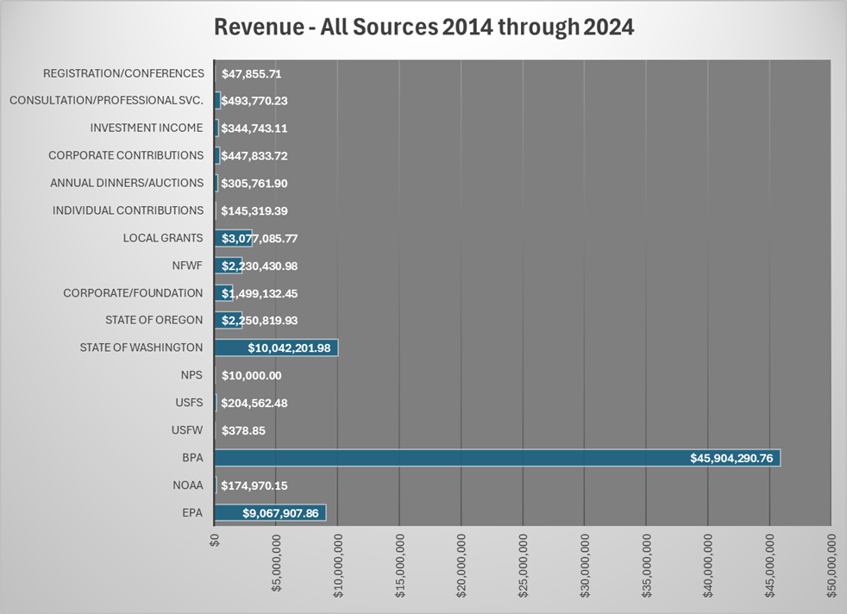
Financial Section:
More historical financial
data
(2014-2024):

Slide 49
Revenue Sources 2014-2024:

Slide 50
Financial Challenges:
Only 1.6% of funds over the period were unrestricted, a total of just over $1 million.
EPA Base Funding accounted for 11% of total funding but sets a very outsized set of requirements and is also one of the few noncompetitive sources of funding for administration and finance.
Diversification of funding to increase the share of funding that comes from sources other than government, particularly federal government.
Diversification of State “base” funds.

Slide 51
Priorities for Funding:
The Estuary Partnership will prioritize funding for projects that support the implementation of activities that meet the goals of the CCMP. In addition to a guiding interest in working to achieve the goals of the CCMP, the Estuary Partnership will prioritize funding that:
Provides funding for communications and outreach with communities and partners;
Provides funding for integrated, cross team collaboration on projects- environmental education components on habitat restoration projects, for example;
Supports establishment of long-term monitoring in the lower river;
Provides funding for the administrative and operational costs associated with implementing the work of the Estuary Partnership;

Slide 52
Short Term Resource Needs – 5 years of less:
Unrestricted revenue to pursue project development and proposal writing
New vehicles
Funding to support limited duration personnel for seasonal and limited duration projects after BIL sunsets
Water trail funding
Ongoing replacement of technology – laptops, towers, servers, software, peripherals
Funding for professional development

Slide 53
Long-Term – 5 to 10 Years:
Review of personnel policies and benefits to attract and retain a new generation of employees
New office space lease that better accommodates parking, storage, security, interior office/structural needs for the team-based workforce
Funding to support habitat restoration projects that may be further afield, beyond the boundaries of the study area

Slide 54
Strategies & Timelines to Develop Additional Revenue:
Need: | Strategies: | Timeline: | Goals:
Increase Unrestricted Funding | Work to build giving campaigns Increase individual giving Build major donor program Review and reconsider annual event approach | Current (2/2025) through mid-2026. Current (2/2025) through end-2026. Engage with a major donor consultant. Early 2026. Build campaign and secure first major donor by early 2027. Review annual event following 2025 39th anniversary. | Increase campaign revenue by 25% by 2027 and 40% by 2030. Increase individual giving by 20% by 2027 and 40% by 2030. Secure major donor by early 2027. Increase annual event revenue by 30% by 2028.

Slide 55
Need: | Strategies: | Timeline: | Goals:
Diversify State Funding Sources | Work with state agencies to identify shared mission and identify potential funding sources | Throughout the 25-27 biennium, work with both states. | Secure funding through one additional state agency by 2028.
Increase Professional Services Income | Respond to RFPs for services – Education, restoration, stormwater, other programming | Current and ongoing | Secure multi-year contracts for at least two program areas by 2027.

Slide 56
Need: | Strategies: | Timeline: | Goals:
Increase funding for administration and operations | No longer write proposals for awards that do not allow indirect cost recovery | Explore the viability of this approach in 2026. | All funders will support the 15% de minimis rate.
Additional project and proposal development funding | Increase EPA Base funding to full appropriation Write proposals for organizational capacity | Work with delegation and ANEP to accomplish Identify and apply for organizational capacity grants beginning in 2025. | Secure full funding by 2026. Secure organizational capacity funds by mid-2026.

Slide 57
Next Steps:
The Board will vote to approve the submittal of the 10-Year Implementation Plan to EPA Region 10 for review and approval.

Slide 58
Last Piece of the Puzzle!
Lower Columbia Estuary Partnership EPA Base Workplan
July 1, 2025 - June 30,2027

Slide 59
Goals for Workplan:

Slide 61
Budget Elements:

Slide 64
Match:

Slide 65
New and Ongoing Activities:
These activities have been updated to reflect changes in the CCMP and Implementation Plan, but each activity includes:
Project Name
Description
CCMP Action
Outputs/Deliverables/Milestones
Environmental Objective/Long-Term Outcomes
Estimated Budget
Lead, Partners and Role
Core Water Program ID

Slide 66
Accomplishments:
This is a key section that identifies not just what we’ve accomplished but also the constraints we’ve felt.
Each program area accomplishment includes:
Project Name
Objectives
Project Description
Lead Implementer, Partners
Accomplishments, Deliverables
Expected Long-Term Outcomes
External Constraints

Slide 67
The Workplan – What to know now:
We do not yet have an appropriated budget total for FY25 or FY26. I have built it on the assumption that we will remain status quo.
Our next fiscal year starts July 1, 2025.
The outcome of whatever budget is adopted by the Federal Government (hopefully) by March 14th will be our budget number. The FY26 appropriation process will commence at some point after that unless there is some odd new process that is conceived.

Slide 68
Why now?
Time is of the essence – which is why you’re getting a Workplan with an uncertain budget.
It takes months to get a Workplan approved, and the expectation is that it will take even longer than normal.
Cashflow in the summer with a major restoration project underway is challenging. Supporting the costs associated with the EPA Base budget without reimbursement for an extended period is not sustainable.

Slide 69
Next Steps:
The Board will need to approve the 2025-2027 Estuary Partnership Workplan for submittal to EPA Region 10 for review and approval.

